Slide 1
Mizuho dashboard
14 Jul 2020
Presented by Mizuho SG Innovation Team

Slide 2
Involved Parties
This is a collaboration between
PQM
AIOD
Tableau
Users
(SG Mizuho Stakeholders)

Slide 3
Objective
To bring Dashboard culture to Mizuho
Using tools such as Tableau, Qlik Sense, Microsoft BI (business intelligence) which are popular analytical dashboard tools
Business users and non-IT savvy staff can easily create the dashboards
Centralising Tableau is the top priority
3

Slide 4
Dashboard Tool - Tableau
What's Tableau
“Grand master” of data visualization software
over 60,000 user accounts across a multitude of industries
interactive interface with simple drag-and-drop functionality speeds up and simplifies the creation process
can easily handle large, fast-changing datasets
integrates smoothly with various technologies e.g. Hadoop, AWS, MySQL, SAP and Teradata

Slide 5
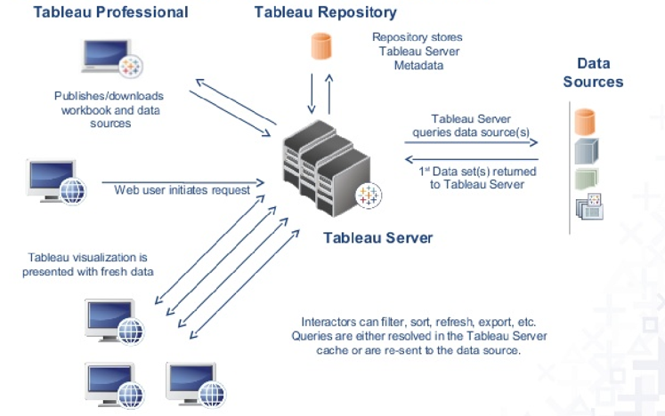
Goal
Deploy Tableau Server to enable collaboration and empower more users to gain insights from the dashboard while ensuring data governance
Centralized environment
Using Active Directory to access i.e. login using own Windows ID
Using web browser, no installation required

Slide 6
Dashboard Tool - Tableau
Tableau is not new to Mizuho
Currently Mizuho have 22 desktop licences (9 desktop, 13 creator) managed by different departments and having different expiry dates
AOOP/AOAD 7 (Desktop-6 Creator-1)
AOTD 3 (Desktop-3)
RMD 3 (Creator-3)
MRD 4 (Creator-4)
AIOD 5 (Creator-5)
6

Slide 7
Timeline

Slide 8
Infra & Deployment
Hardware
AIOD will prepare server by using existing hardware for
Development
Production. Servers are to be confirmed.
Software
- Convert desktop to server license
- Align to same expiry date(Same annual cost when we renew desktop licenses)
- Innovation Team to decide on how many new licenses to purchase
Viewer license
Other Documentation

Slide 9
Next Steps
Training
Tableau
Tableau Virtual Bootcamp – 13 Jul to 24 Jul
Tableau online eLearning – 90 days trial
Innovation Team
Workshops – Aug/Sep
For users who need to create new workbooks, dashboards (Creators)
For users who need to view and interact with published workbooks, dashboards (Viewers)
9

